Slide 1
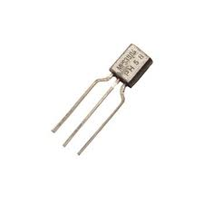
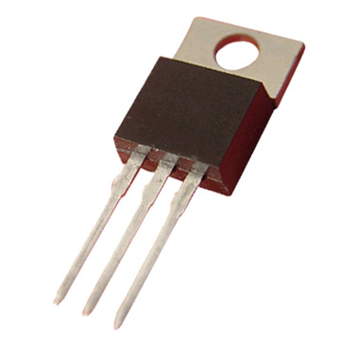
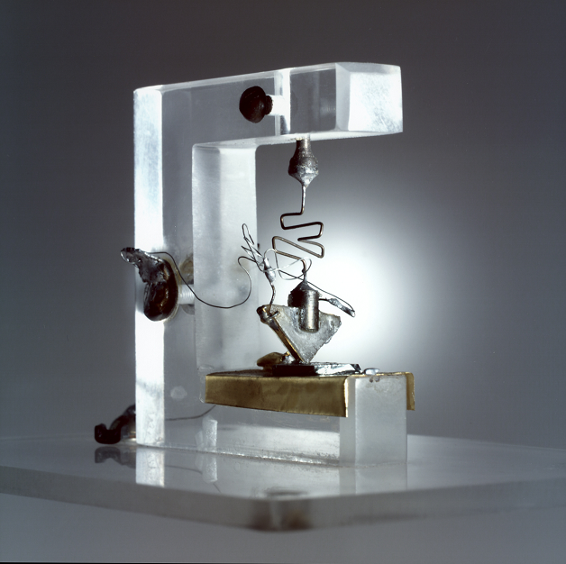
Transistor Lab
Marc Lichtman

Slide 2
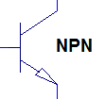
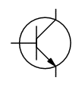
What is a Transistor?
Amplifies current
Semiconductor
  Made out of Silicon
3 pins
  Collector
  Emitter
  Base
NPN or PNP
Used for
  Switching high power
  Logic gates (computers)
  Amplifiers
Different Types
  Bipolar junction transistor (BJT)
  Field-effect transistor (FET)
  Many others

Slide 3
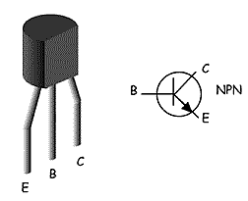
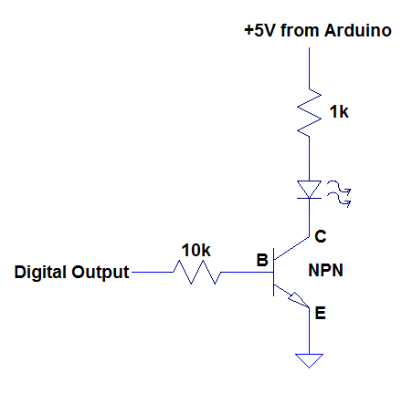
Switching Transistor (NPN)
+5V Power Supply
Big resistor
Long pin
Steps
Measure voltage at B
Calculate currents shown in orange
Measure currents shown in orange
Replace 100k with your body
Measure currents again

